Slide 2
Courage to Confront Disagreements and Issues
Notes:
Facilitator:
If this is the first-time participants are hearing about the Doc B Leadership Academy introduce the Academy. This is a great opportunity to build the “why” behind the “what” of leadership development based on the philosophies and values of Clovis Unified (Script available in resource folder). If this is not the first time briefly review the purpose of the Leadership Academy.

Slide 3
Courage to Confront Disagreements and Issues Values
“Never make excuses, they don’t change the truth.”
Doc Buchanan
Confront the issue with open, honest and healthy conversations.
Treat people with dignity and respect.
Tough conversations make us better.
Notes:
Script: Tier I, II, III
Facilitator:
Today’s philosophy is Courage to Confront Disagreement and Issues. There are 4 values that reflect this philosophy. Facilitator may read, popcorn read, or ask participant to read. Each value will be discussed during our time together, today.
“Never make excuses, they don’t change the truth” is a value that we attribute to Doc Buchanan. The other three values are based on the collaborative effort of all employees and reviewed annually as part of our strategic plan.
Confront the issue with open, honest and healthy conversations.
Treat people with dignity and respect.
Tough conversations make us better.
Ask participants to turn to a neighbor and share one value that resonates with them and explain why.
Ask for volunteers to share the value they selected and why.
Facilitator models, sharing their choice and explaining why.
As each value is shared ask for a show of hands as to who selected it (just a point of interest). Facilitator can comment on which value was selected most often.

Slide 4
Unification: Building a Tradition of Excellence…
“Today our community and our students benefit from high quality, successful schools staffed with outstanding educators. Today’s success comes only because of the battles that were fought and won along the way.”
50 Unified Years, Foreword
Notes:
Script: Tier I, II, III
Facilitator:
Today we are going to spend some time examining the philosophy Courage to Confront Disagreements and Issue. We are going to begin by reading about the unification of Clovis Unified School District. For an overview, read the foreword in the book 50 Unified Years, written by our first Superintendent Dr. Floyd B. Buchanan and Everett “Bud” Rank one of our first Governing Board members (available in resource folder).
Discussion Points:
After reading the forward examine the quote on the screen and discuss the following in a group of three:
101 – Select one of the battles that reflects Courage to Confront Disagreements and Issues early in Clovis Unified history. Does this “battle” resonate with you? Explain why and how.
201 – Do some of these battles still exist today? If so, which one(s)? Describe how they might look different today than 60 years ago.
301 – Identify a “battle” that you face in your department and/or school. Why is the “battle” worth fighting?
Possible responses:
Battle to unify
Board recall
90% of students achieving grade level in reading and math
Competition model
1978 Proposition 13 – keep entire team together without laying anyone off
As groups complete their discussions ask them to share their reflections.

Slide 5
The Governing Board Recall…
“Emotions ran very high during the recall election. Dr. Buchanan stated that a successful recall election was a repudiation of the educational programs he had helped design, and he would have to resign if the incumbents were not returned to office.”
Historical Overview of Clovis Unified School District
Narrative, p. 10
Notes:
Script: Tier I, II, III
Facilitator:
Clovis Unified has had many opportunities to display the Courage to Confront Disagreements and Issue. One of the first “battles” to be fought was the recall attempt of elected Governing Board members in 1964. To better understand why it was a battle please read Choosing a Governing Board and Superintendent beginning on page 10 of the Historical Overview of Clovis Unified School District (available in resource folder).
Discussion Points:
After you finish reading examine the quote on the screen and discuss the following with your neighbor:
101 – During the recall effort Doc made the statement you see on the screen. Why would he make such a bold statement?
201 – Think of a time you or someone you knew had to address a controversial issue and/or disagreement. What steps were followed? What was the outcome?
301 – Think of a time you have had to have a courageous conversation with another individual. Explain what a courageous conversation means to you. Discuss the incident and the outcome. What did you learn from the experience?
As pairs finish their discussions ask them to share. The facilitator should model the process.

Slide 6
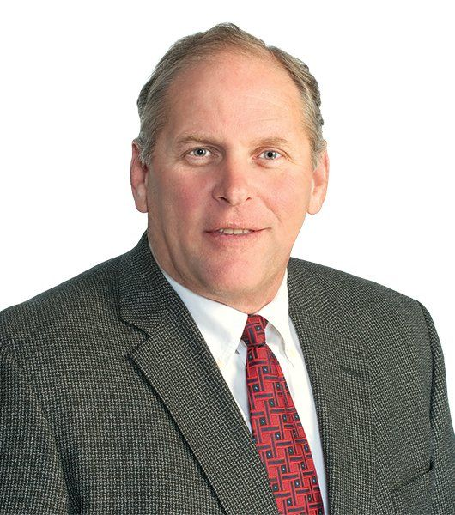
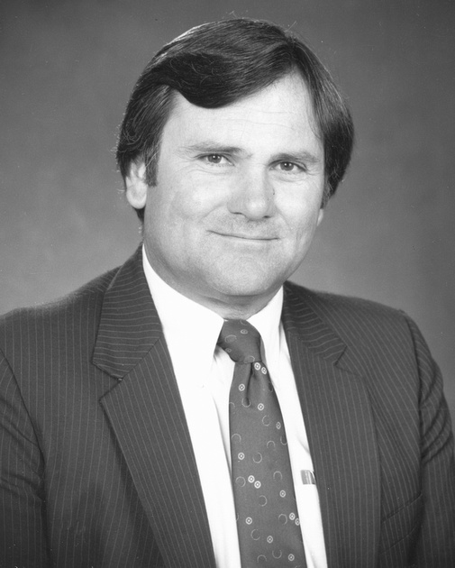
“Never make excuses, they don’t change the truth.”
“He looked across the table and he says, if you can't get it done, I'll find somebody that can. We were to find a way and we weren't going to blame the kids. We weren't going to blame the parents. We were going find a way. That stuck with me for my whole career.”
Rich Smith
Notes:
Script: Tier I, II, III:
Facilitator:
In the video you will hear Rich Smith talk about a discussion he had with Dr. Jim Fugman when he was a new principal at Sierra Vista. Let’s read the quote on the screen and discuss key learnings. Rich served in several leadership roles in Clovis. He went on to be the Deputy Superintendent in Sanger Unified and is currently a national consultant on the Professional Learning Process. Dr. Jim Fugman retired as the Deputy Superintendent for the district. Jim was a firm believer in the value “never make excuses” for himself and those he supervised and mentored.
Discussion Points:
In small job alike groups discuss the following:
101 – What does the value “never make excuses, they don’t change the truth mean? Provide an example.
201 – As a leader how do you “confront” employees who make excuses and/or blame others for their results?
301 – As a leader, how do you hold yourself accountable to this value? Generate a list of the comments you have heard in your school or department that are actually excuses. How do you overcome this mindset?
Facilitator should model. Possible excuses:
The kids don’t know how to read, math facts, write a paragraph.
The teacher before me didn’t teach them x, y, z
The parents don’t help their children
Why do I have to do x, y, z when no one else is doing it?
After everyone is done ask each group to share one of their answers.

Slide 7
Courage to Confront Video
Notes:
Facilitator:
Depending on your time allocation and audience you have several options.
The PowerPoint is designed for you to use the slides, you choose, in any order.

Slide 8
End of Part I
Notes:
Facilitator:
Depending on your time allocation and audience you have several options.
The PowerPoint is designed for you to use the slides, you choose, in any order.

